Slide 1
COMPUTER
SYSTEM
Team Project #1
16102284 이성호
19512004 크리스토프

Slide 2
INDEX
1. Largest Floating Number
2. The way how to represent
the number limited range
3. Arithmetic Operations

Slide 3
Largest Floating Number
Data type | 32 bit OS | 64bit OS
int | 32bit (4 byte) | 32bit
short | 16 bit | 16 bit
long | 32bit | 64 bit
longlong | 64 bit | 64 bit
pointer(*) | 32bit | 64 bit
long double | More 64 bit | (80-128 bit)
size_t , ssize_t | 32bit | 64 bit
typedef

Slide 4
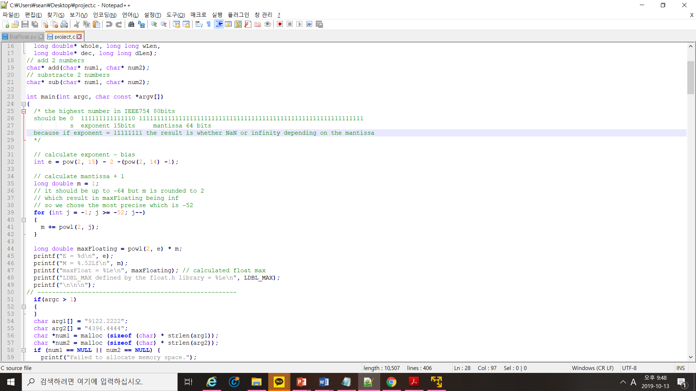
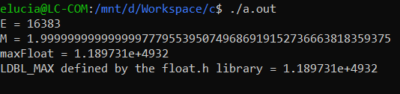
Largest Floating Number

Slide 5
The way how to represent the number limited range
Concept
.
Float’s integer part(integer)
Float’s fraction part(integer)
Think two part of very huge integer!
(if input number bigger than variable, make array)
Combined two part

Slide 6
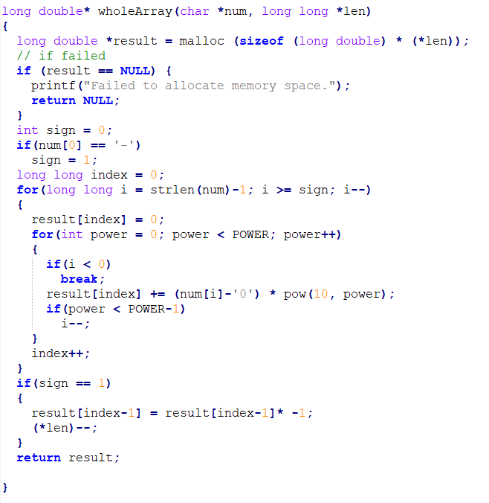
The way how to represent the number limited range

Slide 7
Arithmetic Operations (Addition)
Concept
a=
.
Float’s integer part(integer)
Float’s fraction part(integer)
+
+
b=
.
Float’s integer part(integer)
Float’s fraction part(integer)
c=
.
Float’s integer part(integer)
Float’s fraction part(integer)

Slide 8
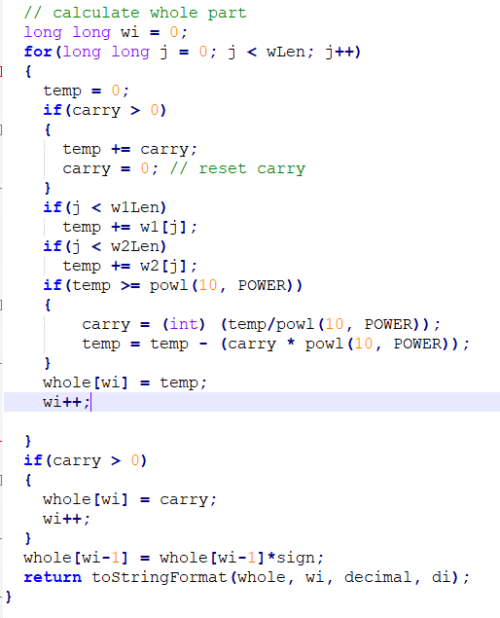
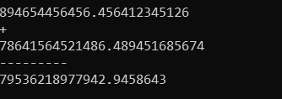
Arithmetic Operations (Addition)

Slide 9
Arithmetic Operations (Subtraction)
Concept
a=
.
Float’s integer part(integer)
Float’s fraction part(integer)
-
-
b=
.
Float’s integer part(integer)
Float’s fraction part(integer)
c=
.
Float’s integer part(integer)
Float’s fraction part(integer)

Slide 10
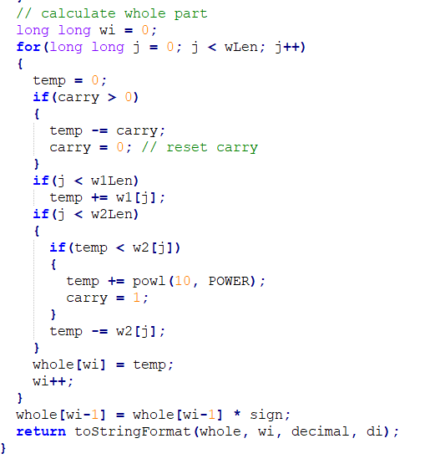
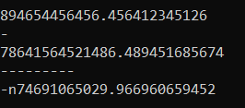
Arithmetic Operations (Subtraction)

Slide 11
Arithmetic Operations (Multiplication)
Concept
Ex) A = a.b , B = c.d (a, b, c, d is integer)
A * B = a.b * c.d = (a + 0.b)*(c + 0.d) = ac + 0.b*c + 0.d*a + 0.b*0.d
= ac + b*c*${10}^{{−b}^{′}s digit}$ +a*d* ${10}^{{−d}^{′}s digit}$ + d*b* ${10}^{{−d}^{′}s digit−b^{′}s digit}$
Case) b * c * ${10}^{{−b}^{′}s digit}$ = P(float)
Put P in the (Input)function
Separate integer part and fraction part
Do the same for everything else and add all.
Multiplication done!

Slide 12
Arithmetic Operations (Division)
Concept
Ex) 129 / 4 = 32 …… 1
⬄ 129 – 4 * 32 = 1
If we subtract the number to be divided as much as divisible number,
times subtracted are quotient, result is remainder!

Slide 13
CONCLUSION

Slide 14


